Slide 1
CREDENCE
Canagliflozin and Renal Events in Diabetes with Established Nephropathy Clinical Evaluation

Slide 2
Presentation Outline
Background and Rationale George Bakris
Study Design and Population Meg J. Jardine
Effects on Renal Outcomes Vlado Perkovic
Effects on CV and Safety Outcomes Kenneth W. Mahaffey
Implications for Clinical Practice David C. Wheeler

Slide 3
CREDENCE
Background and Rationale
George Bakris, MD

Slide 4
Presenter Disclosures:
George Bakris, MD
Research funding, paid to the University of Chicago
  Bayer, Janssen, AbbVie, and Vascular Dynamics
Consultant
  Merck, Vascular Dynamics, Relypsa, Boehringer Ingelheim, Nxstage Medical, Sanofi, AbbVie, Pfizer, Novo Nordisk, and AstraZeneca
Editor
  American Journal of Nephrology
Nephrology and Hypertension Section Editor of UpToDate
Associate Editor
  Diabetes Care, Hypertension Research, and Nephrology Dialysis and Transplantation

Slide 5
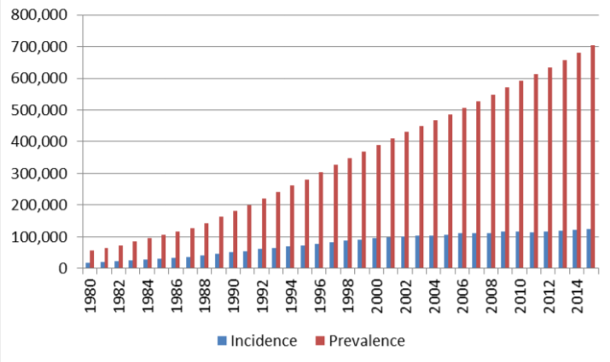
Increasing Incidence and Prevalence of ESKD: US Data
Kirchhoff S. Medicare coverage of end-stage renal disease (ESRD). https://fas.org/sgp/crs/misc/R45290.pdf. Accessed February 13, 2019.

Slide 6
Number of People Receiving Renal Replacement Therapy Is Projected to Double
World
Region
8.0
3.0
7.0
6.0
Asia
(0.97→2.16)
5.0
5.44
2.0
4.53
Number of RRT (×million)
Number of RRT (×million)
4.0
3.78
North America
(0.64→1.26)
3.0
3.13
1.0
Latin America
(0.37→0.90)
2.62
2.0
Europe
(0.53→0.83)
1.0
Africa
(0.08→0.24)
0
0
Oceania
(0.03→0.05)
2010
2015
2020
2025
2030
2010
2015
2020
2025
2030
Year
Year
Liyanage T, et al. Lancet. 2015;385(9981):1975-1982.

Slide 7
Diabetes Is the Leading Cause of Kidney Failure: US Data
60,000
Diabetes
50,000
Hypertension
Glomerulonephritis
40,000
Cystic kidney
Number of patients
30,000
20,000
10,000
0
1980
1985
1990
1995
1995
2000
2005
2010
Year
United States Renal Data System (USRDS). USRDS Annual Report, Chapter 1. https://www.usrds.org/2012/pdf/v2_ch1_12.pdf.
Accessed March 15, 2019.

Slide 8
Dialysis Survival Compared to Common Cancers
Women
Men
100
100
90
90
80
80
70
70
Breast/Prostate Cancer
60
60
Survival probability (%)
Survival probability (%)
Colorectal Cancer
50
50
40
40
Dialysis
30
30
Lung Cancer
20
20
Pancreatic Cancer
10
10
0
0
1997-2001
2002-2006
2007-2011
1997-2001
2002-2006
2007-2011
Era
Era
Unadjusted 10-year survival for all-cause mortality in Canada
N = 33,500 incident maintenance dialysis patients; 532,452 incident cancer patients
Naylor KL, et al. Am J Kidney Dis. 2019. Epub ahead of print. doi:10.1053/j.ajkd.2018.12.011.

Slide 9
Diabetic Kidney Disease Shortens Life Span by 16 Years
65
Men
65
Women
60
60
  Life span loss with:
  Early CKD: 6 years
  Diabetes: 10 years
  Early DKD: 16 years
55
55
50
50
45
45
40
40
Life expectancy (years)
Life expectancy (years)
35
35
30
30
Early DKD: 16.9 years lost at age 30 vs reference
25
Early DKD: 14.8 years lost at age 30 vs reference
25
Reference
20
20
Early CKD
15
15
Diabetes
Early DKD
10
10
30
35
40
45
50
55
60
65
70
30
35
40
45
50
55
60
65
70
Age (years)
Age (years)
Wen CP, et al. Kidney Int. 2017;92(2):388-396.
Notes:
Wen/KI/2017/pg392/figure 3
Wen/KI/2017/pg388/col1/par1/ln 23-25

Slide 10
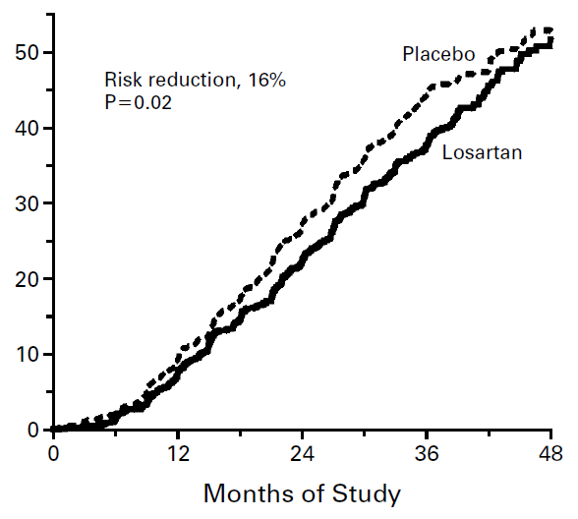
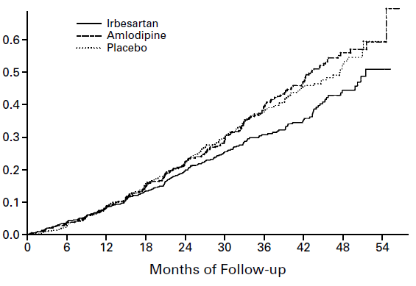
The Only Proven Treatment for Renoprotection in T2DM: RENAAL & IDNT
Doubling of serum creatinine, ESKD, or death
RENAAL
IDNT
Risk reduction, 16%
P = 0.02
Risk reduction, 20%
P = 0.02
Brenner B, et al. N Engl J Med. 2001;345(12):861-869.
Lewis EJ, et al. N Eng J Med. 2001;345(12):851-860.

Slide 11
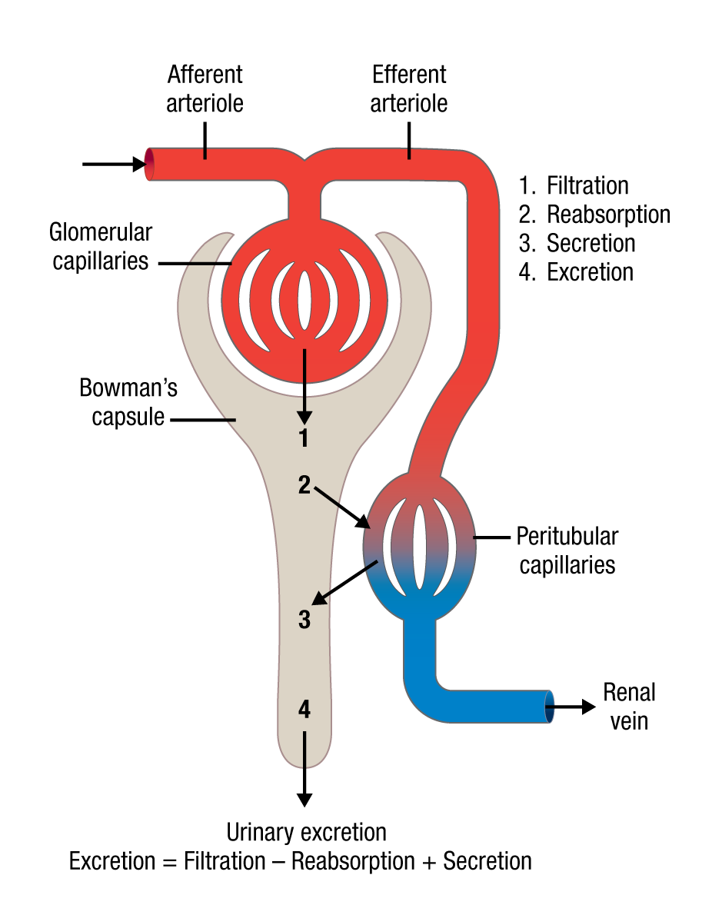
ACEi/ARB Reduce Intraglomerular Pressure: Mechanism for Renal Protection
ACEi and ARB
↓ efferent arteriole tone and
↓ intraglomerular pressure
Initial ↓ in eGFR followed by stabilization
↓ albuminuria
Renal protection
Sternlicht H, Bakris G. Curr Hypertension Rep. 2019;21(2):12-18.
Gilbert RE. Kidney Int. 2014;86(4):693-700.

Slide 12
Since RENAAL and IDNT, New Therapeutic Strategies for Patients With T2DM and CKD Have Failed
Avosentan
Endothelin antagonist²
Sulodexide
Various suggested MoAs⁴
Lisinopril/lorsartan
Dual ACEi/ARB⁶
2010
2012
2007
2011
2013
Ruboxistaurin
PKC-ß inhibitor¹
Pirfenidone
TGF-ß production inhibitor³
Aliskerin
Renin inhibitor⁵
Bardoxolone methyl
Kept1-Nrf2
pathway activator⁷
1. Tuttle KR, et al. Clin J Am Soc Nephrol. 2007;2(4):631-636.
2. Mann JFE, et al. J Am Soc Nephrol. 2010;21(3):527-535.
3. Sharma K, et al. J Am Soc Nephrol. 2011;22(6):1144-1151.
4. Packham DK, et al. J Am Soc Nephrol. 2012;23(1);123-130.
5. Parving HH, et al. N Engl J Med. 2012;367(23):2204-2213.
6. Fried LF, et al. N Engl J Med. 2013;369(20):1892-1903.
7. de Zeeuw D, et al. N Engl J Med. 2013;369(26):2492-2503.

Slide 13
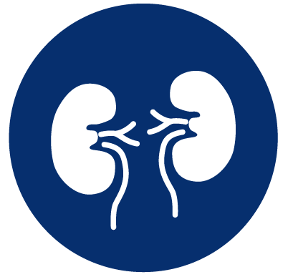
Many Renal Effects of SGLT2 Inhibition Have Been Proposed
Intraglomerular pressure
Glucose
Albuminuria
BP/arterial
stiffness
Oxidant stress
Intrarenal angiotensinogen
upregulation
Volume
Inflammation/fibrosis
And many others…

Slide 14
Timeline of Major SGLT2 Inhibitor Trials
CREDENCE began before any CV outcomes trials had reported
Renal effects were not the primary focus of the CV outcomes trials
EMPA-REG
OUTCOME
CANVAS
Program
DECLARE
2014
2015
2016
2017
2018
CREDENCE
ended
2019
CREDENCE
enrollment

Slide 15
Low Renal Risk Populations in CV Outcomes Trials
MedianUACR (mg/g)
13
12
18
Albuminuria categories (mg/g)
Mean eGFR (mL/min/1.73 m²)
85
76
74
A1: <30
A2: 30-300
A3: >300
DECLARE
CANVAS Program
EMPA-REG OUTCOME
≥90
D
D
C
60-90
C
E
E
45-59
GFR categories
(mL/min/1.73 m²)
30-44
Sustained RRT Events
DECLARE Not reported
CANVAS Program 18
EMPA-REG OUTCOME 11
<30
Low
Moderately
increased
High
Very high
Total of 29 sustained RRT events reported across trials

Slide 16
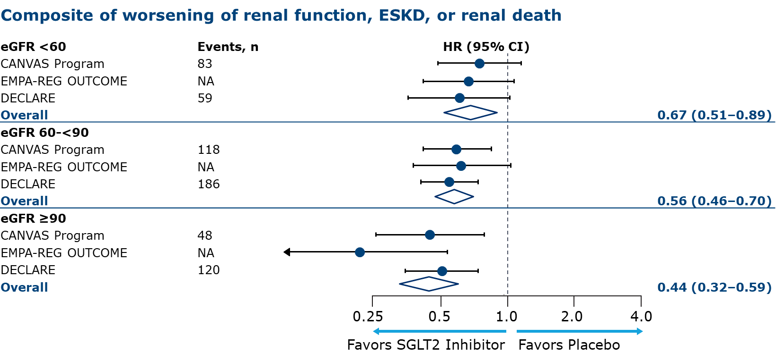
Why Is CREDENCE Important?
CV outcomes trial results suggested possible attenuation of renal effects in patients with reduced kidney function
Interaction
P value = 0.0258
Zelniker TA, et al. Lancet. 2019;393(10166):31-39.

Slide 17
Primary Aim of the CREDENCE Trial
To assess the effects of the SGLT2 inhibitor, canagliflozin,
on clinically important renal outcomes in people with
T2DM and established CKD

Slide 18
CREDENCE
Study Design and Population
Meg J. Jardine, MBBS, PhD, FRACP

Slide 19
Presenter Disclosures:
Meg J. Jardine, MBBS, PhD, FRACP
Supported by a Medical Research Future Fund Next Generation Clinical Researchers Program Career Development Fellowship
Research funding
  Gambro, Baxter, CSL, Amgen, Eli Lilly, and Merck
Advisory boards
  Akebia, Baxter, Boehringer Ingelheim, CSL, and Vifor
Speaker
  Janssen, Amgen, and Roche
Any consultancy, honoraria, or travel support are paid to her institution

Slide 20



Study Organization
Investigators and Study Sites
Safety and Endpoint Adjudication Committees
Steering Committee
V. Perkovic (Chair), K.W. Mahaffey (Co-Chair), R. Agarwal, G. Bakris, B.M. Brenner,
C.P. Cannon, D.M. Charytan, D. de Zeeuw,
T. Greene, M.J. Jardine, H.J.L. Heerspink,
A. Levin, G. Meininger (Sponsor), B. Neal,
C. Pollock, D.C. Wheeler, H. Zhang, B. Zinman
Sponsor
Janssen Research
& Development
Independent Data Monitoring Committee
Academic Research Organization
George Clinical
Contract Research Organization
IQVIA

Slide 21
Objectives
  In people with T2DM, eGFR 30 to 90 mL/min/1.73 m², and UACR 300 to 5000 mg/g
  who are receiving standard of care including a maximum tolerated dose of an ACEi or ARB, to assess whether canagliflozin compared with placebo reduces
  Primary:
    Composite outcome of ESKD, doubling of serum creatinine, or renal or CV death
  Secondary:
    CV death or hospitalization for heart failure
    Major cardiovascular events (3-point MACE: CV death, MI, or stroke)
    Hospitalization for heart failure
    ESKD, doubling of serum creatinine, or renal death
    CV death
    All-cause mortality
    CV death, MI, stroke, hospitalization for heart failure, or hospitalization for unstable angina

Slide 22
Study Design
Key inclusion criteria
≥30 years of age
T2DM and HbA1c 6.5% to 12.0%
eGFR 30 to 90 mL/min/1.73 m²
UACR 300 to 5000 mg/g
Stable max tolerated labelled dose of
ACEi or ARB for ≥4 weeks
Key exclusion criteria
Other kidney diseases, dialysis, or kidney transplant
Dual ACEi and ARB; direct renin inhibitor; MRA
Serum K⁺ >5.5 mmol/L
CV events within 12 weeks of screening
NYHA class IV heart failure
Diabetic ketoacidosis or T1DM
Canagliflozin 100 mg
2-week placebo run-in
R
Double-blind randomization
(1:1)
Placebo
Follow-up at Weeks 3, 13, and 26 (F2F)
then every 13 weeks (alternating phone/F2F)
Participants continued treatment if eGFR was <30 mL/min/1.73 m² until chronic dialysis was initiated or kidney transplant occurred.
Jardine MJ, et al. Am J Nephrol. 2017;46(6):462-472.

Slide 23
Statistical Methods
Intent-to-treat (ITT) principle; event-driven duration
Target of 844 events to provide 90% power to detect 20% relative risk reduction for the primary composite outcome
Outcome analysis based on Cox proportional hazard model stratified by
screening eGFR
Sequential hypothesis testing prespecified to evaluate secondary outcomes
Numbers needed to treat (NNT) to prevent 1 event over 2.5 years were calculated
Subgroup analyses were also prespecified
Jardine MJ, et al. Am J Nephrol. 2017;46(6):462-472.

Slide 24
Prespecified Hierarchical Testing
Primary
ESKD, doubling of serum creatinine, or renal or CV death
Secondary
2. CV death or hospitalization for heart failure
3. CV death, MI, or stroke
4. Hospitalization for heart failure
5. ESKD, doubling of serum creatinine, or renal death
6. CV death
7. All-cause mortality
8. CV death, MI, stroke, hospitalization for heart failure, or hospitalization for unstable angina
Jardine MJ, et al. Am J Nephrol. 2017;46(6):462-472.

Slide 25
Interim Analysis
Planned interim analysis to occur after 405 confirmed primary efficacy endpoints and 2 years of exposure
Reviewed by an Independent Data Monitoring Committee
Prespecified stopping guidance included
  Primary composite: 2-sided P <0.01
  AND
  Composite of ESKD, renal death, or CV death: 2-sided P <0.025
  Global assessment of benefit and safety
Jardine MJ, et al. Am J Nephrol. 2017;46(6):462-472.

Slide 26
Study Timeline and Population

Slide 27




Study Timeline
In July 2018, after the planned interim analysis,
the IDMC made the recommendation to stop the CREDENCE trial based on demonstration of efficacy
Interim analysis
2014
2015
2016
2017
2018
2019
First participant enrolled
Protocol amendment for lower extremity foot care
Last
participant randomized
Study
concluded

Slide 28
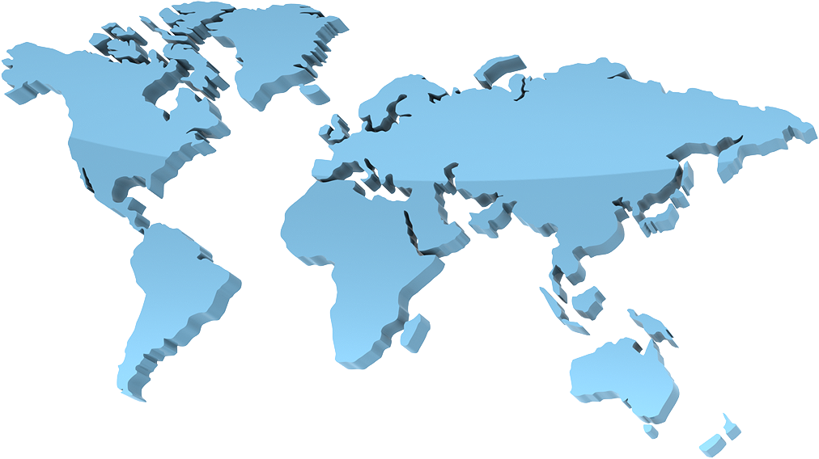
34 Countries, 690 Sites, 4401 Participants
North America (n = 1182)
Canada Mexico United States | (172) (303) (707)
Europe (n = 1368)
Bulgaria Czech Republic France Germany Hungary Italy Lithuania Poland | (29) (57) (61) (11) (135) (90) (7) (50) | Romania Serbia Slovakia Spain Russia* Ukraine* United Kingdom | (59) (40) (66) (141) (133) (371) (118)
Central/South America (n = 941)
Argentina Brazil Chile Colombia Guatemala | (426) (314) (52) (94) (55)
Asia Pacific* (n = 848)
Australia China India Japan Korea Malaysia | (38) (129) (144) (110) (122) (135) | New Zealand Philippines Taiwan United Arab Emirates | (61) (71) (37) (1)
Africa (n = 62)
South Africa* (62)
*Analyzed as part of rest of world (n = 1414) in prespecified subgroup analyses.

Slide 29
Enrollment and Follow-up
12,900 screened
8499 excluded
4401 randomized
2199 placebo
2202 canagliflozin
25 (1.1%) did not complete
11 (0.5%) withdrew consent
15 (0.7%) did not complete
5 (0.2%) withdrew consent
2197 (99.9%)
vital status known
2174 (98.9%)
completed study
2198 (99.8%)
vital status known
2187 (99.3%)
completed study
4395 (99.9%) vital status known; 4361 (99.1%) completed study*
*Patients who completed the study included those who were alive with follow-up at the end of the study or died before final follow-up.

Slide 30
Demographics and Disease History
 | Canagliflozin (n = 2202) | Placebo (n = 2199) | Total (N = 4401)
Mean age, years | 63 | 63 | 63
Female, % | 35 | 33 | 34
Mean duration of diabetes, years | 16 | 16 | 16
Hypertension, % | 97 | 97 | 97
Heart failure (NYHA I-III), % | 15 | 15 | 15
CV disease, % | 51 | 50 | 50
Prior amputation, % | 5 | 5 | 5

Slide 31
Demographics
 | Canagliflozin (n = 2202) | Placebo (n = 2199) | Total (N = 4401)
Race, %
White | 68 | 66 | 67
Asian | 19 | 21 | 20
Black or African American | 5 | 5 | 5
Other | 8 | 9 | 8
Geographic region, %
North America | 26 | 28 | 27
Central/South America | 22 | 21 | 21
Europe | 21 | 19 | 20
Rest of world | 32 | 33 | 32

Slide 32
Baseline Therapies
 | Canagliflozin (n = 2202) | Placebo (n = 2199) | Total (N = 4401)
Glucose-lowering agents, %
Insulin | 66 | 65 | 66
Metformin | 58 | 58 | 58
Sulfonylurea | 28 | 30 | 29
DPP-4 inhibitor | 17 | 17 | 17
GLP-1 receptor agonist | 4 | 4 | 4
Renal and CV protective agents, %
RAAS inhibitor | >99.9 | 99.8 | 99.9
Statin | 70 | 68 | 69
Antithrombotic | 61 | 58 | 60
Beta blocker | 40 | 40 | 40
Diuretic | 47 | 47 | 47

Slide 33
Baseline Risk Factors
 | Canagliflozin (n = 2202) | Placebo (n = 2199) | Total (N = 4401)
HbA1c, % | 8.3 | 8.3 | 8.3
BMI, kg/m² | 31.4 | 31.3 | 31.3
Systolic BP, mmHg | 140 | 140 | 140
Diastolic BP, mmHg | 78 | 78 | 78
Total cholesterol, mmol/L | 4.7 | 4.6 | 4.7
HDL-C, mmol/L | 1.2 | 1.2 | 1.2
LDL-C, mmol/L | 2.5 | 2.5 | 2.5
Triglycerides, mmol/L | 2.2 | 2.2 | 2.2

Slide 34
Baseline Renal Characteristics
 | Canagliflozin (n = 2202) | Placebo (n = 2199) | Total (N = 4401)
Mean eGFR, mL/min/1.73 m² | 56 | 56 | 56
eGFR ≥90, % | 5 | 5 | 5
eGFR ≥60 to <90, % | 36 | 35 | 35
eGFR ≥45 to <60, % | 29 | 29 | 29
eGFR ≥30 to <45, % | 27 | 27 | 27
eGFR <30, % | 4 | 4 | 4
Median UACR (IQR), mg/g | 923 (459-1794) | 931 (473-1868) | 927 (463-1833)
UACR <30, % | <1 | <1 | <1
UACR 30-300, % | 11 | 11 | 11
UACR >300-≤3000, % | 77 | 76 | 77
UACR >3000, % | 11 | 12 | 11

Slide 35
Effects on Intermediate Outcomes

Slide 36
Effects on HbA1c
Canagliflozin
Placebo
Baseline (%)
8.3
8.3
0
–0.1
–0.2
LS mean change (±SE)
in HbA1c (%)
–0.3
–0.4
Mean difference over study
–0.25%
(95% CI: –0.31, –0.20)
–0.5
–0.6
No. of participants
Placebo | 2150 | 2103 | 2066 | 1981 | 1882 | 1728 | 1172 | 688 | 252
Canagliflozin | 2154 | 2108 | 2074 | 2024 | 1909 | 1817 | 1254 | 729 | 274
ITT analysis

Slide 37
Effects on Systolic BP
Canagliflozin
Placebo
Baseline (mmHg)
139.8
140.2
2
1
0
–1
–2
–3
Mean difference over study
–3.30 mmHg
(95% CI: –3.87, –2.73)
–4
–5
No. of participants
Placebo | 2188 | 2131 | 2096 | 2027 | 1923 | 1766 | 1187 | 682 | 245
Canagliflozin | 2190 | 2141 | 2096 | 2047 | 1962 | 1842 | 1261 | 731 | 264
ITT analysis

Slide 38
Effects on Body Weight
Canagliflozin
Placebo
Baseline (kg)
87.3
86.9
1
0
–1
–2
Mean difference over study
–0.80 kg
(95% CI: –0.92, –0.69)
–3
No. of participants
Placebo | 2187 | 2126 | 2092 | 2005 | 1917 | 1750 | 1179 | 679 | 244
Canagliflozin | 2188 | 2134 | 2091 | 2023 | 1957 | 1830 | 1256 | 731 | 263
ITT analysis

Slide 39
Effects on Albuminuria (UACR)
Median baseline (mg/g)
Canagliflozin
Placebo
914
918
Mean % difference over study
–32%
(95% CI: –36, –28)
No. of participants
Placebo | 2113 | 2061 | 1986 | 1865 | 1714 | 1158 | 685 | 251
Canagliflozin | 2114 | 2070 | 2019 | 1917 | 1819 | 1245 | 730 | 271
ITT analysis

Slide 40
CREDENCE
Primary and Renal Outcomes
Vlado Perkovic, MBBS, PhD, FRACP, FASN

Slide 41
Presenter Disclosures:
Vlado Perkovic, MBBS, PhD, FRACP, FASN
Led or served on the Steering Committees of trials
  National Health and Medical Research Council of Australia, Janssen, Abbvie, GSK, Boehringer Ingelheim, Eli Lilly, Gilead, Novartis, Novo Nordisk, Retrophin, Tricida, and Pfizer
Received honoraria for scientific presentations and/or advisory board attendance
  Abbvie, Amgen, Astra Zeneca, Bayer, Baxter, Boehringer Ingelheim, Durect, Eli Lilly, Gilead, GSK, Janssen, Merck, Mitsubishi Tanabe, Novartis, Novo Nordisk, Pharmaling, Pfizer, Reata, Relypsa, Roche, Sanofi, and Servier

Slide 42
Primary Endpoint Definitions
ESKD
  Chronic dialysis for ≥30 days
  Kidney transplantation
  eGFR <15 mL/min/1.73 m² sustained for ≥30 days by central laboratory assessment
Doubling of serum creatinine
  Doubling from the baseline average sustained for ≥30 days by central laboratory assessment
Renal death
  Deaths in patients who have reached ESKD who die prior to initiating renal replacement therapy and no other cause of death is adjudicated
CV death
  Death due to MI, stroke, heart failure, sudden death, death during a CV procedure or as a result of procedure-related complications, presumed sudden CV death, death of unknown cause, or death resulting from a documented CV cause other than those listed

Slide 43
Primary Outcome:
ESKD, Doubling of Serum Creatinine, or Renal or CV Death
Hazard ratio, 0.70 (95% CI, 0.59–0.82)
P = 0.00001
340 participants
245 participants
Participants with an event (%)
Placebo
Canagliflozin
6
12
18
24
30
36
42
No. at risk
Placebo | 2199 | 2178 | 2132 | 2047 | 1725 | 1129 | 621 | 170
Canagliflozin | 2202 | 2181 | 2145 | 2081 | 1786 | 1211 | 646 | 196

Slide 44
ESKD, Doubling of Serum Creatinine, or Renal Death
Hazard ratio, 0.66 (95% CI, 0.53–0.81)
P <0.001
Placebo
Canagliflozin
224 participants
Participants with an event (%)
153 participants
6
12
18
24
30
36
42
No. at risk
Placebo | 2199 | 2178 | 2131 | 2046 | 1724 | 1129 | 621 | 170
Canagliflozin | 2202 | 2181 | 2144 | 2080 | 1786 | 1211 | 646 | 196

Slide 45
End-stage Kidney Disease
Hazard ratio, 0.68 (95% CI, 0.54–0.86)
P = 0.002
Placebo
Canagliflozin
Participants with an event (%)
165 participants
116 participants
6
12
18
24
30
36
42
No. at risk
Placebo | 2199 | 2182 | 2141 | 2063 | 1752 | 1152 | 641 | 178
Canagliflozin | 2202 | 2182 | 2146 | 2091 | 1798 | 1217 | 654 | 199

Slide 46
Dialysis, Kidney Transplantation, or Renal Death*
Hazard ratio, 0.72 (95% CI, 0.54–0.97)
Placebo
Canagliflozin
Participants with an event (%)
105 participants
78 participants
6
12
18
24
30
36
42
No. at risk
Placebo | 2199 | 2183 | 2147 | 2077 | 1776 | 1178 | 653 | 180
Canagliflozin | 2202 | 2184 | 2148 | 2100 | 1811 | 1236 | 661 | 199
*Post hoc analysis.

Slide 47
Summary Forest Plot
 | Hazard ratio (95% CI) |  |  | P value
Primary composite outcome |  |  | 0.70 (0.59–0.82) | 0.00001
Doubling of serum creatinine |  |  | 0.60 (0.48–0.76) | <0.001
ESKD |  |  | 0.68 (0.54–0.86) | 0.002
eGFR <15 mL/min/1.73 m² |  |  | 0.60 (0.45–0.80) | –
Dialysis initiated or kidney transplantation |  |  | 0.74 (0.55–1.00) | –
Renal death |  |  | 0.39 (0.08–2.03) | –
CV death |  |  | 0.78 (0.61–1.00) | 0.0502
ESKD, doubling of serum creatinine, or renal death |  |  | 0.66 (0.53–0.81) | <0.001
Dialysis, kidney transplantation, or renal death* |  |  | 0.72 (0.54–0.97) | –
0.25
0.5
1.0
2.0
4.0
Favors Canagliflozin
Favors Placebo
*Post hoc analysis.

Slide 48
Primary Outcome by Screening eGFR and Albuminuria
 | Hazard ratio (95% CI) |  | Interaction P value
Screening eGFR |  |  | 0.11
30 to <45 mL/min/1.73 m² |  | 0.75 (0.59–0.95)
45 to <60 mL/min/1.73 m² |  | 0.52 (0.38–0.72)
60 to <90 mL/min/1.73 m² |  | 0.82 (0.60–1.12)
Baseline UACR |  |  | 0.49
≤1000 mg/g |  | 0.76 (0.55–1.04)
>1000 mg/g |  | 0.67 (0.55–0.81)
0.25
0.5
1.0
2.0
4.0
Favors Canagliflozin
Favors Placebo

Slide 49
Primary Outcome: Demographic and Risk Factor Subgroups
 | Hazard ratio (95% CI) |  |  | Interaction P value
Sex |  |  |  | 0.84
Male |  |  | 0.69 (0.56–0.84)
Female |  |  | 0.71 (0.54–0.95)
Age |  |  |  | 0.83
<65 years |  |  | 0.64 (0.51–0.79)
≥65 years |  |  | 0.77 (0.60–1.00)
Baseline BMI |  |  |  | 0.26
<30 kg/m² |  |  | 0.71 (0.56–0.89)
≥30 kg/m² |  |  | 0.68 (0.54–0.86)
Baseline HbA1c |  |  |  | 0.22
<8% |  |  | 0.77 (0.61–0.99)
≥8% |  |  | 0.63 (0.51–0.79)
Systolic BP |  |  |  | 0.61
≤Median |  |  | 0.67 (0.52–0.85)
>Median |  |  | 0.72 (0.58–0.90)
0.25
0.5
1.0
2.0
Favors Canagliflozin
Favors Placebo

Slide 50
Primary Outcome: Demographic Subgroups
 | Hazard ratio (95% CI) |  |  | Interaction P value
Race |  |  |  | 0.91
White |  |  | 0.70 (0.57–0.86)
Black or African American |  |  | 0.83 (0.43–1.60)
Asian |  |  | 0.66 (0.46–0.95)
Other |  |  | 0.71 (0.43–1.18)
Ethnicity |  |  |  | 0.55
Hispanic or Latino |  |  | 0.62 (0.47–0.81)
Not Hispanic or Latino |  |  | 0.74 (0.60–0.91)
Not reported/unknown |  |  | –*
Region |  |  |  | 0.18
North America |  |  | 0.84 (0.63–1.13)
Central/South America |  |  | 0.61 (0.43–0.88)
Europe |  |  | 0.82 (0.54–1.24)
Rest of world |  |  | 0.58 (0.43–0.78)
0.25
0.5
1.0
2.0
Favors Canagliflozin
Favors Placebo
*Hazard ratios and 95% CIs were calculated for outcomes with >10 events.

Slide 51
Primary Outcome: Disease History Subgroups
 | Hazard ratio (95% CI) |  |  | Interaction P value
Diabetes duration ≥median |  |  |  | 0.86
Yes |  |  | 0.71 (0.57–0.88)
No |  |  | 0.68 (0.53–0.87)
History of CV disease |  |  |  | 0.91
Yes |  |  | 0.70 (0.56–0.88)
No |  |  | 0.69 (0.54–0.88)
History of amputation |  |  |  | 0.37
Yes |  |  | 0.59 (0.33–1.04)
No |  |  | 0.71 (0.60–0.84)
History of heart failure |  |  |  | 0.16
Yes |  |  | 0.89 (0.61–1.31)
No |  |  | 0.66 (0.55–0.79)
0.25
0.5
1.0
2.0
Favors Canagliflozin
Favors Placebo

Slide 52
Effects on eGFR
Canagliflozin
Placebo
Baseline
56.4
56.0
–0.55
–3.72
–1.85/year
LS mean change (±SE) in
eGFR (mL/min/1.73 m²)
Acute eGFR slope (3 weeks)
Difference: –3.17 (95% CI, –3.87, –2.47)
–4.59/year
Chronic eGFR slope
Difference: 2.74/year (95% CI, 2.37–3.11)
6
12
18
24
30
36
42
No. of Participants
Placebo | 2178 | 2084 | 1985 | 1882 | 1720 | 1536 | 1006 | 583 | 210
Canagliflozin | 2179 | 2074 | 2005 | 1919 | 1782 | 1648 | 1116 | 652 | 241
On treatment

Slide 53
Summary
Canagliflozin reduced the risk of the primary outcome of ESKD, doubling of serum creatinine, or renal or CV death by 30% (P = 0.00001)
  The results were consistent across a broad range of prespecified subgroups
Canagliflozin also reduced the risk of the secondary outcome of ESKD,
doubling of serum creatinine, or renal death by 34% (P <0.001)
Similar risk reductions were seen for exploratory outcomes assessing components of the primary outcome
  ESKD: 32% lower (95% CI, 14–46)
  Dialysis, transplantation, or renal death: 28% lower (95% CI, 3–46)
Canagliflozin attenuated the slope of chronic eGFR decline
by 2.7 mL/min/1.73 m²/year (1.9 vs 4.6)

Slide 54
CREDENCE
Secondary CV Outcomes
Kenneth W. Mahaffey, MD

Slide 55
Presenter Disclosures:
Kenneth W. Mahaffey, MD
Research support
  Afferent, Amgen, Apple, Inc., AstraZeneca, Cardiva Medical, Inc., Daiichi, Ferring, Google (Verily), Johnson & Johnson, Luitpold, Medtronic, Merck, NIH, Novartis, Sanofi, St. Jude, and Tenax
Consultant (speaker fees for CME events only)
  Abbott, Ablynx, AstraZeneca, Baim Institute, Boehringer Ingelheim, Bristol Myers Squibb, Elsevier, GlaxoSmithKline, Johnson & Johnson, MedErgy, Medscape, Mitsubishi, Myokardia, NIH, Novartis, Novo Nordisk, Portola, Radiometer, Regeneron, Springer Publishing,
  and UCSF

Slide 56
CV-related Baseline Demographics
 | Canagliflozin (n = 2202) | Placebo (n = 2199) | Total (N = 4401)
Hypertension, % | 97 | 97 | 97
Heart failure (NYHA I-III), % | 15 | 15 | 15
CV disease, % | 51 | 50 | 50
Renal and CV protective agents, %
RAAS inhibitor | >99.9 | 99.8 | 99.9
Statin | 70 | 68 | 69
Antithrombotic | 61 | 58 | 60
Beta blocker | 40 | 40 | 40
Diuretic | 47 | 47 | 47

Slide 57
CV Death or Hospitalization for Heart Failure
Hazard ratio, 0.69 (95% CI, 0.57–0.83)
P <0.001
Placebo
Canagliflozin
253 participants
Participants with an event (%)
179 participants
6
12
18
24
30
36
42
No. at risk
Placebo | 2199 | 2165 | 2123 | 2044 | 1736 | 1147 | 638 | 170
Canagliflozin | 2202 | 2171 | 2132 | 2077 | 1789 | 1226 | 668 | 199

Slide 58
Major Cardiovascular Events: CV Death, MI, or Stroke
Hazard ratio, 0.80 (95% CI, 0.67–0.95)
P = 0.01
Placebo
Canagliflozin
269 participants
Participants with an event (%)
217 participants
6
12
18
24
30
36
42
No. at risk
Placebo | 2199 | 2152 | 2100 | 2022 | 1717 | 1143 | 635 | 168
Canagliflozin | 2202 | 2163 | 2106 | 2047 | 1756 | 1196 | 642 | 198

Slide 59
Hospitalization for Heart Failure
Hazard ratio, 0.61 (95% CI, 0.47–0.80)
P <0.001
Placebo
Canagliflozin
Participants with an event (%)
141 participants
89 participants
6
12
18
24
30
36
42
No. at risk
Placebo | 2199 | 2165 | 2122 | 2043 | 1735 | 1147 | 638 | 170
Canagliflozin | 2202 | 2171 | 2131 | 2076 | 1789 | 1226 | 668 | 199

Slide 60
CV Death
Hazard ratio, 0.78 (95% CI, 0.61–1.00)
P = 0.0502
Placebo
Canagliflozin
Participants with an event (%)
140 participants
110 participants
6
12
18
24
30
36
42
No. at risk
Placebo | 2199 | 2185 | 2160 | 2106 | 1818 | 1220 | 688 | 189
Canagliflozin | 2202 | 2187 | 2155 | 2120 | 1835 | 1263 | 687 | 212

Slide 61
Summary
Primary | Hazard ratio (95% CI) | P value
1. ESKD, doubling of serum creatinine, or renal or CV death | 0.70 (0.59–0.82) | 0.00001
Secondary
2. CV death or hospitalization for heart failure | 0.69 (0.57–0.83) | <0.001
3. CV death, MI, or stroke | 0.80 (0.67–0.95) | 0.01
4. Hospitalization for heart failure | 0.61 (0.47–0.80) | <0.001
5. ESKD, doubling of serum creatinine, or renal death | 0.66 (0.53–0.81) | <0.001
6. CV death | 0.78 (0.61–1.00) | 0.0502
7. All-cause mortality | 0.83 (0.68–1.02) | –
8. CV death, MI, stroke, hospitalization for heart failure, or hospitalization for unstable angina | 0.74 (0.63–0.86) | –
✔
✔
✔
✔
✔
Not significant
Not formally
tested
Not formally
tested

Slide 62
Summary
Canagliflozin resulted in a clinically important and
statistically significant reduction in kidney failure and
major cardiovascular outcomes

Slide 63
CREDENCE
Safety Outcomes

Slide 64
Safety Analyses
Independent blinded Endpoint Adjudication Committees adjudicated all suspected fractures, pancreatitis, diabetic ketoacidosis, and renal cell carcinoma events
Other AEs of interest included
      Renal-related AEs
      Acute kidney injury
      Hyperkalemia
      Amputation
      Male and female genital mycotic infections
      Urinary tract infections
      Volume depletion–related AEs

Slide 65
AEs and Serious AEs
 | Number of participants with an event, n
 | Canagliflozin (N = 2200) | Placebo (N = 2197) | Hazard ratio (95% CI)
All AEs | 1784 | 1860 |  | 0.87 (0.82–0.93)
All serious AEs | 737 | 806 |  | 0.87 (0.79–0.97)
0.5
1.0
2.0
Favors Canagliflozin
Favors Placebo
Includes all treated participants through 30 days after last dose.

Slide 66
Renal Safety
 | Number of participants with an event, n
 | Canagliflozin (N = 2200) | Placebo (N = 2197) | Hazard ratio (95% CI)
All renal-related AEs | 290 | 388 |  | 0.71 (0.61–0.82)
Hyperkalemia | 151 | 181 |  | 0.80 (0.65–1.00)
Acute kidney injury | 86 | 98 |  | 0.85 (0.64–1.13)
0.5
1.0
2.0
Favors Canagliflozin
Favors Placebo
Includes all treated participants through 30 days after last dose.

Slide 67
Other AEs of Interest
 | Number of participants with an event, n
 | Canagliflozin (N = 2200) | Placebo (N = 2197) | Hazard ratio (95% CI)
Male genital mycotic infections* | 28 | 3 |  | 9.30 (2.83–30.60)
Female genital mycotic infections† | 22 | 10 |  | 2.10 (1.00–4.45)
Urinary tract infections | 245 | 221 |  | 1.08 (0.90–1.29)
Volume depletion–related AEs | 144 | 115 |  | 1.25 (0.97–1.59)
Malignancies‡ | 98 | 99 |  | 0.98 (0.74–1.30)
Renal cell carcinoma | 1 | 5 |  | 0.20 (0.02–1.68)
Breast† | 8 | 3 |  | 2.59 (0.69–9.76)
Bladder | 10 | 9 |  | 1.10 (0.45–2.72)
Acute pancreatitis | 5 | 2 |  | 2.44 (0.47–12.59)
Diabetic ketoacidosis | 11 | 1 |  | 10.80 (1.39–83.65)
Includes all treated participants through 30 days after last dose except cancer, which includes all treated patients through the end of the trial.
0.125
0.25
0.5
1.0
2.0
4.0
8.0
16.0
32.0
Favors Canagliflozin
Favors Placebo
*Includes male participants only (canagliflozin, n = 1439; placebo, n = 1466).
†Includes female participants only (canagliflozin, n = 761; placebo, n = 731).
‡Includes malignant tumors of unspecified type.

Slide 68
Fracture
Hazard ratio, 0.98 (95% CI, 0.70–1.37)
Placebo
Canagliflozin
Participants with an event (%)
68 participants
67 participants
6
12
18
24
30
36
42
No. at risk
Placebo | 2197 | 2166 | 2128 | 2061 | 1769 | 1178 | 656 | 176
Canagliflozin | 2200 | 2171 | 2121 | 2074 | 1785 | 1225 | 668 | 200
Includes all treated patients through the end of the trial.

Slide 69
Lower Extremity Amputation
Hazard ratio, 1.11 (95% CI, 0.79–1.56)
Placebo
Canagliflozin
Participants with an event (%)
70 participants
63 participants
6
12
18
24
30
36
42
No. at risk
Placebo | 2197 | 2169 | 2131 | 2065 | 1766 | 1177 | 658 | 182
Canagliflozin | 2200 | 2163 | 2118 | 2071 | 1788 | 1228 | 667 | 202
Includes all treated patients through the end of the trial.

Slide 70
Summary
No difference in risk was observed with canagliflozin compared with placebo for:
  Fracture
  Amputation
Safety profile was otherwise consistent with previous canagliflozin studies

Slide 71
CREDENCE
Implications for Clinical Practice
David C. Wheeler, MD, FRCP

Slide 72
Presenter Disclosures:
David C. Wheeler, MD, FRCP
Consultant
  Amgen, AstraZeneca, Bayer, Boehringer Ingelheim, GlaxoSmithKline, Janssen, Mundipharma, Mitsubishi, Napp, Ono Pharma, and Vifor Fresenius

Slide 73


Growing Problem of T2DM and CKD
~422
adults are
living with
diabetes
Deaths due to
T2DM and CKD
MILLION
94%
Number of Deaths
30 to 40%
of these patients will develop CKD
1990
2012
World Health Organization. Global Report on Diabetes. 2016.
Yee J. Diabetes Spectr. 2008;21(1):8-10.
Alicic RZ, et al. Clin J Am Soc Nephrol. 2017;12(12):2032-2045.

Slide 74
Risk Factor Management at Entry to CREDENCE
Mean HbA1c 8.3%
99.9% on ACEi or ARB
Lower blood glucose
Initiate when albumin excretion is ≥30 mg/g
ACEi or
ARB
Glucose
BP
Lipids
Manage BP levels
Lower LDL-C
Mean BP 140/78 mmHg
~70% on statin
Baseline values from CREDENCE are shown.
Molitch ME, et al. Kidney Int. 2015;87(1):20-30.
National Institute for Health and Care Excellence. NICE guideline (NG28). 2017. Accessed April 10, 2019.
American Diabetes Association. Diabetes Care. 2019;42(Suppl 1):S182-S183.

Slide 75
Study Quality Metrics:
CREDENCE vs Other Long-term Outcome Trials in Diabetes
Trial | N | Median follow-up duration | Unknown final vital status, n (%) | Withdrawal of consent, n (%) | Study completion, n (%) | Discontinuation of study drug, n (%)
CREDENCE (canagliflozin) | 4401 | 2.6 years | 6 (0.1) | 16 (0.4) | 4361 (99.1) | 1201 (27.3)
CANVAS Program (canagliflozin)¹ | 10,142 | 2.4 years | 34 (0.3) | 140 (1.4) | 9734 (96.0) | 2990 (29.5)
EMPA-REG OUTCOME (empagliflozin)² | 7020 | 3.1 years | 53 (0.8) | 102 (1.5) | 6809 (97.0) | 1780 (25.4)
DECLARE (dapagliflozin)³ | 17,160 | 4.2 years | NR | 224 (1.3) | 16,906 (98.5) | 3962 (23.1)
TECOS (sitagliptin)⁴ | 14,671 | 3.0 years | 368 (2.5) | 662 (4.5) | 13,877 (94.6) | 3356 (22.9)
SAVOR-TIMI 53 (saxagliptin)⁵ | 16,492 | 2.1 years | 147 (0.9) | 388 (2.4) | 16,076 (97.5) | 3232 (19.6)
LEADER (liraglutide)⁶ | 9340 | 3.8 years | 29 (0.3) | NR | 9042 (96.8) | NR
1. Neal B, et al. N Engl J Med. 2017;377(7):644-657.
2. Zinman B, et al. N Engl J Med. 2015;373(22):2117-2128.
3. Wiviott SD, et al. N Engl J Med. 2019;380(4):347-357.
4. Green JB, et al. N Engl J Med. 2015;373(3):232-242.
5. Scirica BM, et al. N Engl J Med. 2013;369(14):1317-1326.
6. Marso SP, et al. N Engl J Med. 2016;375(4):311-322.

Slide 76
Higher Renal Risk Population in CREDENCE
MedianUACR (mg/g)
13
12
18
927
Albuminuria categories (mg/g)
Mean eGFR (mL/min/1.73 m²)
85
76
74
56
A1: <30
A2: 30-300
A3: >300
DECLARE
CANVAS Program
EMPA-REG OUTCOME
CREDENCE
≥90
D
D
C
60-90
C
E
E
45-59
GFR categories
(mL/min/1.73 m²)
30-44
Sustained RRT Events
DECLARE Not reported
CANVAS Program 18
EMPA-REG OUTCOME 11
CREDENCE 176
<30
Low
Moderately
increased
High
Very high

Slide 77
Lower Baseline Renal Function in CREDENCE Participants
CANVAS
Program¹
EMPA-REG
OUTCOME²
DECLARE³
CREDENCE
eGFR
<60
UACR >300
20
40
60
80
100
1. Neal B, et al. N Engl J Med. 2017;377(7):644-657.
2. Zinman B, et al. N Engl J Med. 2015;373(22):2117-2128.
3. Raz I, et al. Diabetes Obes Metab. 2018;20(5):1102-1110.

Slide 78
Summary of Key Renal and CV Outcomes
 | Hazard ratio (95% CI) |  |  | P value
Primary composite outcome |  |  | 0.70 (0.59–0.82) | 0.00001
Doubling of serum creatinine |  |  | 0.60 (0.48–0.76) | <0.001
ESKD |  |  | 0.68 (0.54–0.86) | 0.002
eGFR <15 mL/min/1.73 m² |  |  | 0.60 (0.45–0.80) | –
Dialysis initiated or kidney transplantation |  |  | 0.74 (0.55–1.00) | –
Renal death |  |  | 0.39 (0.08–2.03) | –
CV death |  |  | 0.78 (0.61–1.00) | 0.0502
CV death or hospitalization for heart failure |  |  | 0.69 (0.57–0.83) | <0.001
CV death, MI, or stroke |  |  | 0.80 (0.67–0.95) | 0.01
Hospitalization for heart failure |  |  | 0.61 (0.47–0.80) | <0.001
ESKD, doubling of serum creatinine, or renal death |  |  | 0.66 (0.53–0.81) | <0.001
0.25
0.5
1.0
2.0
4.0
Favors Canagliflozin
Favors Placebo

Slide 79
Lower Extremity Amputation
 | Participants with an event per 1000 patient-years (n/N) |  | IRD per 1000 patient-years (95% CI) | Hazard ratio (95% CI)
 | Canagliflozin | Placebo
CREDENCE | 12.3 (70/2200) | 11.2 (63/2197) | 1.16 (–2.87, 5.18) |  | 1.11 (0.79–1.56)
CANVAS Program¹ | 6.3 (140/5790) | 3.4 (47/4344) | 2.93 (1.50, 4.36) |  | 1.97 (1.41–2.75)
0.5
1.0
2.0
4.0
Favors Canagliflozin
Favors Placebo
Whether the increased risk of lower limb amputation in the CANVAS Program was due to differing trial populations or protocols, or to chance remains unclear
IRD, incidence rate difference.
1. Neal B, et al. N Engl J Med. 2017;377(7):644-657.

Slide 80

NNT for Renal and CV Outcomes Over 2.5 Years
Primary composite
outcome
ESKD, doubling of serum creatinine, or renal death
ESKD
22
28
43
Hospitalization for heart failure
CV death, MI, or stroke
46
40

Slide 81
Primary Outcome: Benefits in eGFR 30 to <45 Subgroup
 | Hazard ratio (95% CI) |  | Interaction P value
Screening eGFR |  |  | 0.11
30 to <45 mL/min/1.73 m² |  | 0.75 (0.59–0.95)
45 to <60 mL/min/1.73 m² |  | 0.52 (0.38–0.72)
60 to <90 mL/min/1.73 m² |  | 0.82 (0.60–1.12)
0.25
0.5
1.0
2.0
4.0
Favors Canagliflozin
Favors Placebo
NNT in patients with eGFR 30 to <45 mL/min/1.73 m²
16

Slide 82
Conclusion
Canagliflozin safely reduced the risk of kidney failure and prevented CV events in people with T2DM and CKD

Slide 83
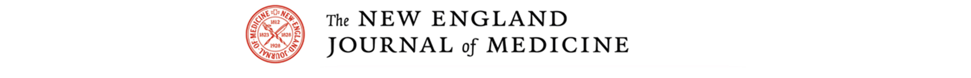
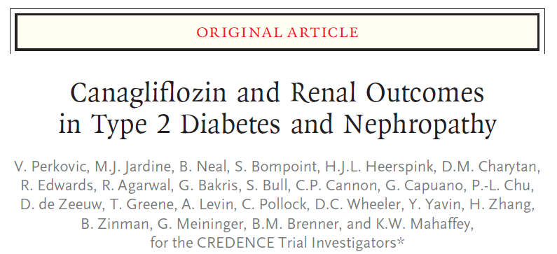
Slides available at www.georgeinstitute.org and http://med.stanford.edu/sccr.html
Paper and editorial available at www.nejm.org

Slide 84
Thanks to the Participants and the following people for their contributions:

Slide 85
Thanks to the Participants and the following people for their contributions:
Steering Committee: Vlado Perkovic (Chair), Kenneth W. Mahaffey (co-chair), Rajiv Agarwal, George Bakris, Barry M. Brenner, Christopher P. Cannon, David M. Charytan, Dick de Zeeuw, Tom Greene, Meg J. Jardine, Hiddo J.L. Heerspink, Adeera Levin, Gary Meininger (Sponsor), Bruce Neal, Carol Pollock, David C. Wheeler, Hong Zhang, and Bernard Zinman
Regional Lead Investigators: Meg Jardine (Global Scientific Lead), Hiddo J.L. Heerspink (Europe Regional Scientific Lead), David M. Charytan (Americas Regional Scientific Lead), Nicole Li, and Inna Kolesnyk (Asia Pacific Regional Scientific Leads)
Janssen and George Clinical Teams: Maria Ali, Jim Baldassarre, Dainius Balis, Scott Bull, William Canovatchel, George Capuano, Jun Chen, Pei-Ling Chu, Trokon Cooke, Jag Craig, Jacki Danyluk, Mehul Desai, Robert Edwards, Lyndal Hones, Alan Jenkins, Mary Kavalam, Cha-Chi Lo, Xinchao Luo, Rich Oh, Rose Qiu, Norm Rosenthal, Nicole Schmitt, Danielle Siebenkaess, Roger Simpson, Tao Sun,
Anna Temu, Payal Thakkar, Michele Wells, Yshai Yavin, Renata Yong, and Kimberly Dittmar and Alaina Mitsch (MedErgy)
Independent Data Monitoring Committee: Darren Maguire (chair), Rury Holman, Philip Home, Dan Scharfstein, and Patrick Parfrey
National Lead Investigators: Diego Aizenberg (Argentina and Chile), Roberto Pecoits-Filho (Brazil), Adeera Levin and David Cherney (Canada), Gregorio Obrador (Mexico, Colombia, and Guatemala), Glenn Chertow and Tara Chang (United States), Carmel Hawley (Australia and New Zealand), Linong Ji and Hong Zhang (China), Takashi Wada (Japan), Vivekanand Jha (India), Soo Kun Lim (Malaysia), Mary Anne Lim-Abrahan and Florence Santos (Philippines), Dong-Wan Chae (South Korea), Shang-Jyh Hwang (Taiwan), Evgueniy Vazelov (Bulgaria), Ivan Rychlík (Czech Republic and Slovakia), Samy Hadjadj (France), Vera Krane (Germany), László Rosivall (Hungary), Luca De Nicola (Italy), Alexander Dreval (Lithuania and Russia), Michał Nowicki (Poland), Adalbert Schiller (Romania), Larry Distiller (South Africa),
Jose L Górriz (Spain), Mykola Kolesnyk (Ukraine), and David C. Wheeler (United Kingdom)
Endpoint Adjudication Committee:
Rajiv Agarwal (chair), Kenneth W. Mahaffey (co-chair), Shahnaz Shahinfar, Phyllis August, Tara Chang, Arjun D. Sinha, James Januzzi, Daniel Kolansky, John Amerena, Graham Hillis, Philip Gorelick, Brett Kissela, Scott Kasner, Richard Lindley, and Greg Fulcher
Safety Adjudication:
Fracture Adjudication: Souhila Ounadjela, Karina Hufert, and Gabriele von Ingersleben (Bioclinica)
Diabetic Ketoacidosis Adjudication: Janson Gagila, Ronald Harris, Margo Hudson, and Alexander Turchin (Baim)
Pancreatitis Adjudication: Adam Cheifetz, Sunil Sheth, and Joseph Feuerstein (Baim)
Renal Cell Carcinoma Adjudication: Samuel Cohen

Slide 86
Thanks to the Participants and the following people for their contributions:
Steering Committee: Vlado Perkovic (Chair), Kenneth W. Mahaffey (co-chair), Rajiv Agarwal, George Bakris, Barry M. Brenner, Christopher P. Cannon, David M. Charytan, Dick de Zeeuw, Tom Greene, Meg J. Jardine, Hiddo J.L. Heerspink, Adeera Levin, Gary Meininger (Sponsor), Bruce Neal, Carol Pollock, David C. Wheeler, Hong Zhang, and Bernard Zinman
Regional Lead Investigators: Meg Jardine (Global Scientific Lead), Hiddo J.L. Heerspink (Europe Regional Scientific Lead), David M. Charytan (Americas Regional Scientific Lead), Nicole Li, and Inna Kolesnyk (Asia Pacific Regional Scientific Leads)
Janssen and George Clinical Teams: Maria Ali, Jim Baldassarre, Dainius Balis, Scott Bull, William Canovatchel, George Capuano, Jun Chen, Pei-Ling Chu, Trokon Cooke, Jag Craig, Jacki Danyluk, Mehul Desai, Robert Edwards, Lyndal Hones, Alan Jenkins, Mary Kavalam, Cha-Chi Lo, Xinchao Luo, Rich Oh, Rose Qiu, Norm Rosenthal, Nicole Schmitt, Danielle Siebenkaess, Roger Simpson, Tao Sun,
Anna Temu, Payal Thakkar, Michele Wells, Yshai Yavin, Renata Yong, and Kimberly Dittmar and Alaina Mitsch (MedErgy)
CREDENCE Investigators
Argentina: Rodolfo Andres Ahuad Guerrero, Diego Aizenberg, Juan Pablo Albisu, Andres Alvarisqueta, Ines Bartolacci, Mario Alberto Berli, Anselmo Bordonava, Pedro Calella, Maria Cecilia Cantero, Luis Rodolfo Cartasegna, Esteban Cercos, Gabriela Cecilia Coloma, Hugo Colombo, Victor Commendatore, Jesus Cuadrado, Carlos Alberto Cuneo, Ana Maria Cusumano, Walter Guillermo Douthat, Ricardo Dario Dran, Eduardo Farias, Maria Florencia Fernandez, Hernan Finkelstein, Guillermo Fragale, Jose Osvaldo Fretes, Nestor Horacio Garcia, Anibal Gastaldi, Elizabeth Gelersztein, Jorge Archibaldo Glenny, Joaquin Pablo Gonzalez, Patricia del Carmen Gonzalez Colaso, Claudia Goycoa, Gustavo Cristian Greloni, Adrian Guinsburg, Sonia Hermida, Luis Isaias Juncos, Maria Isabel Klyver, Florencia Kraft, Fernando Krynski, Paulina Virginia Lanchiotti, Ricardo Alfonso Leon de la Fuente, Nora Marchetta, Pablo Mele, Silvia Nicolai, Pablo Antonio Novoa, Silvia Ines Orio, Fabian Otreras, Alejandra Oviedo, Pablo Raffaele, Jorge Hector Resk, Lucas Rista, Nelson Rodriguez Papini, Jorgelina Sala, Juan Carlos Santos, Lilia Beatriz Schiavi, Horacio Sessa, Tomas Smith Casabella, Maria Rosa Ulla, Augusto Vallejos, Adriana Villarino, Virginia Esther Visco, Alfredo Wassermann, and Cesar Javier Zaidman
Australia: Ngai Wah Cheung, Carolyn Droste, Ian Fraser, David Johnson, Peak Mann Mah, Kathy Nicholls, David Packham, Joseph Proietto, Anthony Roberts, Simon Roger, and Venessa Tsang
Brazil: Roberto Abrão Raduan, Fernando Augusto Alves da Costa, Celso Amodeo, Luiz Alberto Andreotti Turatti, Rachel Bregman, Fernanda Cristina Camelo Sanches, Luis Henrique Canani, Antônio Roberto Chacra, João Lindolfo Cunha Borges, Sérgio Alberto Cunha Vêncio, Roberto Jorge da Silva Franco, Domingos d’Avila, Evandro de Souza Portes, Pedro de Souza, Luciane Mônica Deboni, Fadlo Fraige Filho, Bruno Geloneze Neto, Marcus Gomes, Suely Keiko Kohara, Elizete Keitel, Jose Francisco Kerr Saraiva, Hugo Roberto Kurtz Lisboa, Fabiana Loss de Carvalho Contieri, Rosângela Milagres, Renan Montenegro Junior, Claudia Moreira de Brito, Miguel Nasser Hissa, Ângela Regina Nazario Sabbag, Irene Noronha, Daniel Panarotto, Roberto Pecoits Filho, Márcio Antônio Pereira, Wladmir Saporito, Antonio Scafuto Scotton, Tiago Schuch, Roberto Simões de Almeida, Cássio Slompo Ramos, João Soares Felício, Fernando Thomé, Jean Carlo Tibes Hachmann, Sérgio Yamada, Cesar Yoiti Hayashida, Tarissa Beatrice Zanata Petry, and Maria Teresa Zanella
Bulgaria: Viktoria Andreeva, Angelina Angelova, Stefan Dimitrov, Veselka Genadieva, Gabriela Genova-Hristova, Kiril Hristozov, Zdravko Kamenov, Atanas Koundurdjiev, Lachezar Lozanov, Viktor Margaritov, Boyan Nonchev, Rangel Rangelov, Alexander Shinkov, Margarita Temelkova, Ekaterina Velichkova, and Andrian Yakov
Canada: Naresh Aggarwal, Ronnie Aronson, Harpreet Bajaj, David Cherney, Guy Chouinard, James Conway, Serge Cournoyer, Gerald DaRoza, Sacha De Serres, François Dubé, Ronald Goldenberg, Anil Gupta, Milan Gupta, Sam Henein, Hasnain Khandwala, Lawrence Leiter, Adeera Levin, François Madore, Alan McMahon, Norman Muirhead, Vincent Pichette, Remi Rabasa-Lhoret, Andrew Steele, Navdeep Tangri, Ali Torshizi, Vincent Woo, and Nadia Zalunardo
Chile: María Alicia Fernández Montenegro, Juan Gonzalo Godoy Jorquera, Marcelo Medina Fariña, Victor Saavedra Gajardo, and Margarita Vejar
China: Nan Chen, Qinkai Chen, Shenglian Gan, Yaozhong Kong, Detian Li, Wenge Li, Xuemei Li, Hongli Lin, Jian Liu, Weiping Lu, Hong Mao, Yan Ren, Weihong Song, Jiao Sun, Lin Sun, Ping Tu, Guixia Wang, Jinkui Yang, Aiping Yin, Xueqing Yu, Minghui Zhao, and Hongguang Zheng
Colombia: Jose Luis Accini Mendoza, Edgar Arcos, Jorge Avendano, Jorge Ernesto Andres Diaz Ruiz, Luis Hernando Garcia Ortiz, Alexander Gonzalez, Eric Hernandez Triana, Juan Diego Higuera, Natalia Malaver, Dora Inés Molina de Salazar, Ricardo Rosero, Monica Alexandra Terront Lozano, Luis Valderrama Cometa, Alex Valenzuela, Ruben Dario Vargas Alonso, Ivan Villegas, and Hernan Yupanqui
Czech Republic: Dagmar Bartaskova, Petr Barton, Jana Belobradkova, Lenka Dohnalova, Tomas Drasnar, Richard Ferkl, Katarina Halciakova, Vera Klokocnikova, Richard Kovar, Jiri Lastuvka, Martin Lukac, Satu Pesickova, Karel Peterka, Jiri Pumprla, Ivan Rychlik, Frantisek Saudek, Vladimir Tesar, Martin Valis, Pavel Weiner, and Stanislav Zemek
France: Eric Alamartine, Sophie Borot, Bertrand Cariou, Bertrand Dussol, Jean-Pierre Fauvel, Pierre Gourdy, Alexandre Klein, Yannick Le Meur, Alfred Penfornis, Ronan Roussel, Pierre-Jean Saulnier, Eric Thervet, and Philippe Zaoui
Germany: Volker Burst, Markus Faghih, Grit Faulmann, Hermann Haller, Reinhold Jerwan-Keim, Stephan Maxeiner, Björn Paschen, Georg Plassmann, and Ludger Rose
Guatemala: Ronaldo Arturo Gonzalez Orellana, Franklin Paul Haase, Juan Pablo Moreira Diaz, Luis Alberto Ramirez Roca, Jose Antonio Sánchez Arenales, José Vicente Sanchez Polo, and Erick Turcios Juarez
Hungary: Gyongyi Csecsei, Botond Csiky, Peter Danos, Laszlo Deak, Mihaly Dudas, Eleonora Harcsa, Katalin Keltai, Sandor Keresztesi, Krisztian Kiss, Laszlo Konyves, Lajos Major, Margit Mileder, Marta Molnar, Janos Mucsi, Tamas Oroszlan, Ivan Ory, Gyorgy Paragh, Eva Peterfai, Gizella Petro, Katalin Revesz, Robert Takacs, Sandor Vangel, Szilard Vasas, and Marianna Zsom
Independent Data Monitoring Committee: Darren Maguire (chair), Rury Holman, Philip Home, Dan Scharfstein, and Patrick Parfrey
National Lead Investigators: Diego Aizenberg (Argentina and Chile), Roberto Pecoits-Filho (Brazil), Adeera Levin and David Cherney (Canada), Gregorio Obrador (Mexico, Colombia, and Guatemala), Glenn Chertow and Tara Chang (United States), Carmel Hawley (Australia and New Zealand), Linong Ji and Hong Zhang (China), Takashi Wada (Japan), Vivekanand Jha (India), Soo Kun Lim (Malaysia), Mary Anne Lim-Abrahan and Florence Santos (Philippines), Dong-Wan Chae (South Korea), Shang-Jyh Hwang (Taiwan), Evgueniy Vazelov (Bulgaria), Ivan Rychlík (Czech Republic and Slovakia), Samy Hadjadj (France), Vera Krane (Germany), László Rosivall (Hungary), Luca De Nicola (Italy), Alexander Dreval (Lithuania and Russia), Michał Nowicki (Poland), Adalbert Schiller (Romania), Larry Distiller (South Africa),
Jose L Górriz (Spain), Mykola Kolesnyk (Ukraine), and David C. Wheeler (United Kingdom)
India: Oomman Abraham, Raju Sree Bhushan, Dewan Deepak, Fernando M. Edwin, Natarajan Gopalakrishnan, Noble Gracious, Alva Hansraj, Dinesh Jain, C. B. Keshavamurthy, Dinesh Khullar, Sahay Manisha, Jayameena Peringat, Narayan Prasad, Rao K. Satyanarayana, Reddy Sreedhar, Melemadathil Sreelatha, Bhimavarapu Sudhakar, and Ramesh Chandra Vyasam
Italy: Riccardo Bonadonna, Pietro Castellino, Antonio Ceriello, Luca Chiovato, Salvatore De Cosmo, Luca De Nicola, Giuseppe Derosa, Alberto Di Carlo, Graziano Di Cianni, Giovanni Frascà, Giorgio Fuiano, Giovanni Gambaro, Giacomo Garibotto, Carlo Giorda, Fabio Malberti, Marcora Mandreoli, Edoardo Mannucci, Emanuela Orsi, Piermarco Piatti, Domenico Santoro, Ferdinando Carlo Sasso, Gaetano Serviddio, Andrea Stella, Roberto Trevisan, and Anna Maria Veronelli
Japan: Hitoshi Akiyama, Hiromi Aoki, Akimichi Asano, Tadashi Iitsuka, Shizuo Kajiyama, Susumu Kashine, Toshio Kawada, Takamoto Kodera, Hiroshi Kono, Kazunori Koyama, Yasuro Kumeda, Shozo Miyauchi, Kazuyuki Mizuyama, Tetsuji Niiya, Hiroko Oishi, Satoshi Ota, Terue Sakakibara, Masahiko Takai, Osamu Tomonaga, Mitsuru Tsujimoto, Takashi Wada, Masakiyo Wakasugi, Yasushi Wakida, Takayuki Watanabe, Masayo Yamada, Kazuhiro Yanagida, Toshihiko Yanase, and Wataru Yumita
Lithuania: Egle Gaupsiene, Dalia Kozloviene, Antanas Navickas, and Egle Urbanaviciene
Malaysia: Rohana Abdul Ghani, Khalid Abdul Kadir, Norsiah Ali, Mohd Daud Che Yusof, Chye Lee Gan, Mastura Ismail, Wei Yen Kong, Swee Win Lam, Li Yuan Lee, Soo Kun Lim, Chek Loong Loh, Anita Bhajan Manocha, Kee Sing Ng, Nik Nur Fatnoon Nik Ahmad, Vanassa Ratnasingam, Saiful Shahrizal Bin Shudim, and Paranthaman Vengadasalam
Mexico: Luis David Abraira Munoz, Melchor Alpizar Salazar, Juan Baas Cruz, Mario Burgos Soto, Jose Chevaile Ramos, Alfredo Chew Wong, Jose Ricardo Correa Rotter, Tonatiu Diaz Escalante, Favio Edmundo Enriquez Sosa, Fernando Flores Lozano, Luis Fernando Flota Cervera, Paul Frenk Baron, Cecilia Garcia Ballesteros, Jose David Gomez Rangel, Luis Enrique Herrera Jimenez, Sergio Saul Irizar Santana, Fernando Jimenez Flores, Hugo Laviada Molina, Rosa Isela Luna Ceballos, Belia Martin del Campo Blanco, Guadalupe Morales Franco, Oscar Tarsicio Moreno Loza, Cynthia Mustieles Rocha, Gregorio Obrador Vera, Ricardo Orozco Castellanos, Juan Peralta Calcaneo, Miguel Angel Reyes Rosano, Hiromi Rodriguez Pattzi, Juan Rosas Guzman, Isabel Erika Rucker Joerg, Sandra Berenice Saavedra Sanchez, Jose Hector Sanchez Mijangos, Pablo Serrano Sanson, Juan Alfredo Tamayo y Orozco, Eloisa Tellez Chavez, Alejandro Valdes Cepeda, Luis Venegas Carrillo, Juan Villagordoa Mesa, and Rolando Zamarripa Escobedo
New Zealand: John Baker, Paul Noonan, Russell Scott, Robert Walker, Edward Watson, Michael Williams, and Simon Young
Philippines: Zaynab Abejuela, Jeimeen Agra, Grace Aquitania, Clodoaido Caringal, Rhea Severina Comia, Lalaine Delos Santos, Olivert Gomez, Cecilia Jimeno, Florence Santos, Gerry Tan, Marsha Tolentino, Christy Yao, Yvette Ethel Yap, and Ma. Dovie Lallaine Ygpuara
Poland: Renata Bijata-Bronisz, Lucyna Hotlos, Andrzej Januszewicz, Barbara Kaczmarek, Anna Kaminska, Lech Lazuka, Andrzej Madej, Stanislaw Mazur, Dorota Mlodawska-Choluj, Michal Nowicki, Grazyna Orlowska-Kowalik, Grazyna Popenda, Barbara Rewerska, and Dariusz Sowinski
Romania: Liliana Monica Angelescu, Veronica Anghel, Rodica-Ioana Avram, Mihaela-Magdalena Busegeanu, Adriana Cif, Dana Cosma, Carmen Crisan, Luiza Despina Demian, Ioana Emilia Ferariu, Ildiko Halmagyi, Nicolae Hancu, Mircea Munteanu, Doru Negru, Adriana Gabriela Onaca, Ligia Petrica, Amorin Remus Popa, Aurelian-Emil Ranetti, Cristian Serafinceanu, and Cristina Toarba
Russia: Alina Agafyina, Olga Barbarash, Olga Barysheva, Daniil Chizhov, Vladimir Dobronravov, Alexander Dreval, Irina Glinkina, Elena Grineva, Vladimir Khirmanov, Elena Kolmakova, Tatiana Koroleva, Liudmila Kvitkova, Viacheslav Marasaev, Ashot Mkrtumyan, Tatiana Morugova, Galina Nagibovich, Oleg Nagibovich, Sergei Nedogoda, Irina Osipova, Tatiana Raskina, Yulia Samoylova, Olga Sazonova, Minara Shamkhalova, Elena Shutemova, Yuriy Shwartz, Oleg Uriasyev, Sergey Vorobyev, Anna Zateyshchikova, Dmitry Zateyshshikov, and Tatyana Zykova
Serbia: Slobodan Antic, Miodrag Djordjevic, Aleksandra Kendereski, Katarina Lalic, Nebojsa Lalic, and Vesna Popovic-Radinovic
Slovakia: Jana Babikova, Olga Benusova, Ingrid Buganova, Jan Culak, Andrej Dzupina, Jana Dzuponova, Peter Fulop, Adriana Ilavska, Emil Martinka, Zuzana Ochodnicka, Daniel Pella, and Iveta Smatanova
South Africa: Fayzal Ahmed, Aysha Badat, Johannes Breedt, Lawrence Distiller, Vimladhevi Govender, Ravendran Govender, Mukesh Joshi, Jaco Jurgens, Gulam Latiff, Landman Lombard, Mohamed Mookadam, Nomangesi Ngcakani, Hendrik Nortje, Helena Oosthuizen, Larisha Pillay-Ramaya, Hans Prozesky, Jeevren Reddy, Paul Rheeder, and Mary Seeber
South Korea: Dong-Wan Chae, Young Min Cho, In-Kyung Jeong, Sin Gon Kim, Yeong Hoon Kim, Hyuk-Sang Kwon, Min Jeong Kwon, Byung-Wan Lee, JungEun Lee, Moon-Kyu Lee, Moon-Suk Nam, Kook-Hwan Oh, Cheol-Young Park, Sun-Hee Park, and Kun Ho Yoon
Endpoint Adjudication Committee:
Rajiv Agarwal (chair), Kenneth W. Mahaffey (co-chair), Shahnaz Shahinfar, Phyllis August, Tara Chang, Arjun D. Sinha, James Januzzi, Daniel Kolansky, John Amerena, Graham Hillis, Philip Gorelick, Brett Kissela, Scott Kasner, Richard Lindley, and Greg Fulcher
Safety Adjudication:
Fracture Adjudication: Souhila Ounadjela, Karina Hufert, and Gabriele von Ingersleben (Bioclinica)
Diabetic Ketoacidosis Adjudication: Janson Gagila, Ronald Harris, Margo Hudson, and Alexander Turchin (Baim)
Pancreatitis Adjudication: Adam Cheifetz, Sunil Sheth, and Joseph Feuerstein (Baim)
Renal Cell Carcinoma Adjudication: Samuel Cohen
Spain: Pere Alvarez Garcia, Luis Asmarats Mercadal, Clara Barrios, Fernando Cereto Castro, Secundino Cigarran Guldris, Marta Dominguez Lopez, Jesus Egido de los Rios, Gema Fernandez Fresnedo, Antonio Galan Serrano, Isabel Garcia, Francisco Javier Gonzalez Martinez, Jose Esteban Jodar Gimeno, Manuel Lopez Mendoza, Tamara Malek Marin, Cristobal Morales Portillo, Maria Antonia Munar Vila, Manuel Muñoz Torres, Javier Nieto Iglesias, Jonay Pantoja Perez, Merce Perez Vera, Jose Mª Portoles Perez, María Angustias Quesada Simón, Rafael Simo Canonge, Alfonso Soto Gonzalez, Manel Terns Riera, Francisco Jose Tinahones Madueno, and Mercedes Velo Plaza
Taiwan: Chwen-Tzuei Chang, Lee-Ming Chuang, Te-Lin Hsia, Chang-Hsun Hsieh, Shang-Jyh Hwang, Chih-Ching Lin, Yung-Chuan Lu, and Wayne H-H Sheu
Ukraine: Olga Barna, Svitlana D. Bilyk, Volodymyr Botsyurko, Iryna Dudar, Ivan Fushtey, Olga Godlevska, Oleksandr Golovchenko, Olga Gyrina, Anatoliy Kazmirchuk, Mykola Kolesnyk, Iuliia Komisarenko, Oleksii Korzh, Nonna Kravchun, Oleg Legun, Borys Mankovskyy, Liliya Martynyuk, Yuriy Mostovoy, Nataliia Pashkovska, Larysa Pererva, Tetyana Pertseva, Oleksandr Samoylov, Ivan Smirnov, Yevgeniya Svyshchenko, Galyna Tomashkevych, Ivan Topchii, Nadiya Tryshchuk, Vira Tseluyko, Vadym Vizir, Maryna Vlasenko, Tetiana Zlova, and Liliia Zub
United Arab Emirates: Salah Abusnana and Mohamed Railey
United Kingdom: Kamal Abouglila, Paul Ainsworth, Zishan Ali, Vijayaraman Arutchelvam, Maria Barnard, Srikanth Bellary, Emyr Davies, Mark Davies, Simon Davies, Alison Dawson, Mohsen El Kossi, Patrick English, Donald Fraser, Luigi Gnudi, Anthony Gunstone, Timothy Hall, Wasim Hanif, Alan Jackson, Andrew Johnson, Franklin Joseph, Singhan Krishnan, Mick Kumwenda, Iain MacDougall, Paul Nixon, Joseph O'Hare, Sam Philip, Shenaz Ramtoola, Manish Saxena, Davesh Sennik, Godwin Simon, Baldev Singh, Jeffrey Stephens, Anna Strzelecka, Rehan Symonds, Wayne Turner, Mona Wahba, John Wakeling, David Wheeler, and Peter Winocour
United States: Joseph Abdallah, Raied Abdullah, Matthew Abramowitz, Idalia Acosta, Joseph Aiello, Laura Akright, Ayim Akyea-Djamson, Rajendran Alappan, Radica Alicic, Amer Al-Karadsheh, Dale Crawford Allison, Carlos Arauz-Pacheco, Shahabul Arfeen, Ahmed Arif, Moogali Arvind, Naveen Atray, Ahmed Awad, George Bakris, Peggy Barnhill, Elizabeth Barranco, Carlos Barrera, Matthew Beacom, Venkata Behara, Diogo Belo, Rhonda Bentley-Lewis, Ramon Berenguer, Lidia Bermudez, Marializa Bernardo, Mihaela Biscoveanu, Cynthia Bowman-Stroud, Donald Brandon, Osvaldo Brusco, Robert Busch, Yamil Canaan, Alicia Chilito, Tom Christensen, Cynthia Christiano, Elena Christofides, Caroucel Chuateco, Kenneth Cohen, Robert Cohen, Debbie Cohen-Stein, Charles Cook, Daniel Coyne, Nizar Daboul, Riad Darwish, Adarsh Daswani, Kenneth Deck, Cyrus Desouza, Devasmita Dev, Monika Dhillon, Sohan Dua, Frank Eder, Ana Maria Elosegui, Mohamed El-Shahawy, John Ervin, Alberto Esquenazi, John Evans, Steven Fishbane, Juan Frias, Eugenia Galindo-Ramos, Claude Galphin, Adline Ghazi, Enrique Gonzalez, David Gorson, Anupama Gowda, Barbara Greco, Stephen Grubb, Rakesh Gulati, Jamal Hammoud, Stuart Handelsman, Israel Hartman, Kenneth Hershon, Daniel Hiser, George Hon, Radu Jacob, Maria Jaime, Aamir Jamal, Charles Kaupke, Gerald Keightley, Elizabeth Kern, Rakhi Khanna, Zeid Khitan, Sun Kim, Nelson Kopyt, Csaba Kovesdy, Gopal Krishna, Jeffrey (Jay) Kropp, Amrendra Kumar, Jayant Kumar, Neil Kumar, Jorge Kusnir, Wendy Lane, Mary Lawrence, Lawrence Lehrner, John Lentz, Dennis Levinson, Derek Lewis, Kenneth Liss, Andreas Maddux, Hiralal Maheshwari, Sreedhar Mandayam, Isam Marar, Bhasker Mehta, John Middleton, Jorge Mordujovich, Ramon Moreda, Moustafa Moustafa, Samuel Mujica Trenche, Mohanram Narayanan, Javier Narvarte, Tareq Nassar, George Newman, Brian Nichol, Philip Nicol, Josier Nisnisan, A. Kaldun Nossuli, Chamberlain Obialo, Sarah Olelewe, Michael Oliver, Andrew O'Shaughnessy, John Padron, Rohit Pankhaniya, Reginald Parker, Devesh Patel, Gnyandev Patel, Nina Patel, Humberto Pavon, Armando Perez, Carlos Perez, Alan Perlman, Karlton Pettis, Walter Pharr, Andrea Phillips, Raman Purighalla, Luis Quesada-Suarez, Rajiv Ranjan, Sanjeev Rastogi, Jakkidi Reddy, Marc Rendell, Lisa Rich, Michael Robinson, Hector Rodriguez, Sylvia Rosas, Fadi Saba, Rallabhandi Sankaram, Ravi Sarin, Robert Schreiman, David Scott, Mohamed Sekkarie, John Sensenbrenner, Muhammad Shakeel, Michael Shanik, Sylvia Shaw, Stephen Smith, Richard Solomon, Amy Sprague, Leslie Spry, Pusadee Suchinda, Senan Sultan, Prasanth Surampudi, Sherry Sussman, Anjanette Tan, Antonio Terrelonge, Michael Thompson, Fernando Trespalacios, Bruce Trippe, Pilar Trueba, Marcel Twahirwa, John Updegrove, Peter Van Buren, Mark Vannorsdall, Freemu Varghese, Pedro Velasquez-Mieyer, Sailaja Ventrapragada, Goga Vukotic, Khurram Wadud, Mark Warren, Henry Watson, Ronald Watts, Daniel Weiner, James Welker, Jean Welsh, Shelley Williams, and Michelle Zaniewski-Singh

